Slide 1



California
Water
Environment
Association
LOCAL SECTION LEADER ORIENTATION
UPDATED APRIL 2024

Slide 2
FIRST OFF…
CWEA 2023 Leadership Retreat, Asilomar State Park Hotel & Conference Grounds, © CWEA
Notes:
Thanks for having me
Introduce yourself if no one has
Thank the local section leadership for being there. We do all this work together – maybe tell a little of your story as a volunteer with CWEA and how you got involved and how it is meaningful to your career.

Slide 3
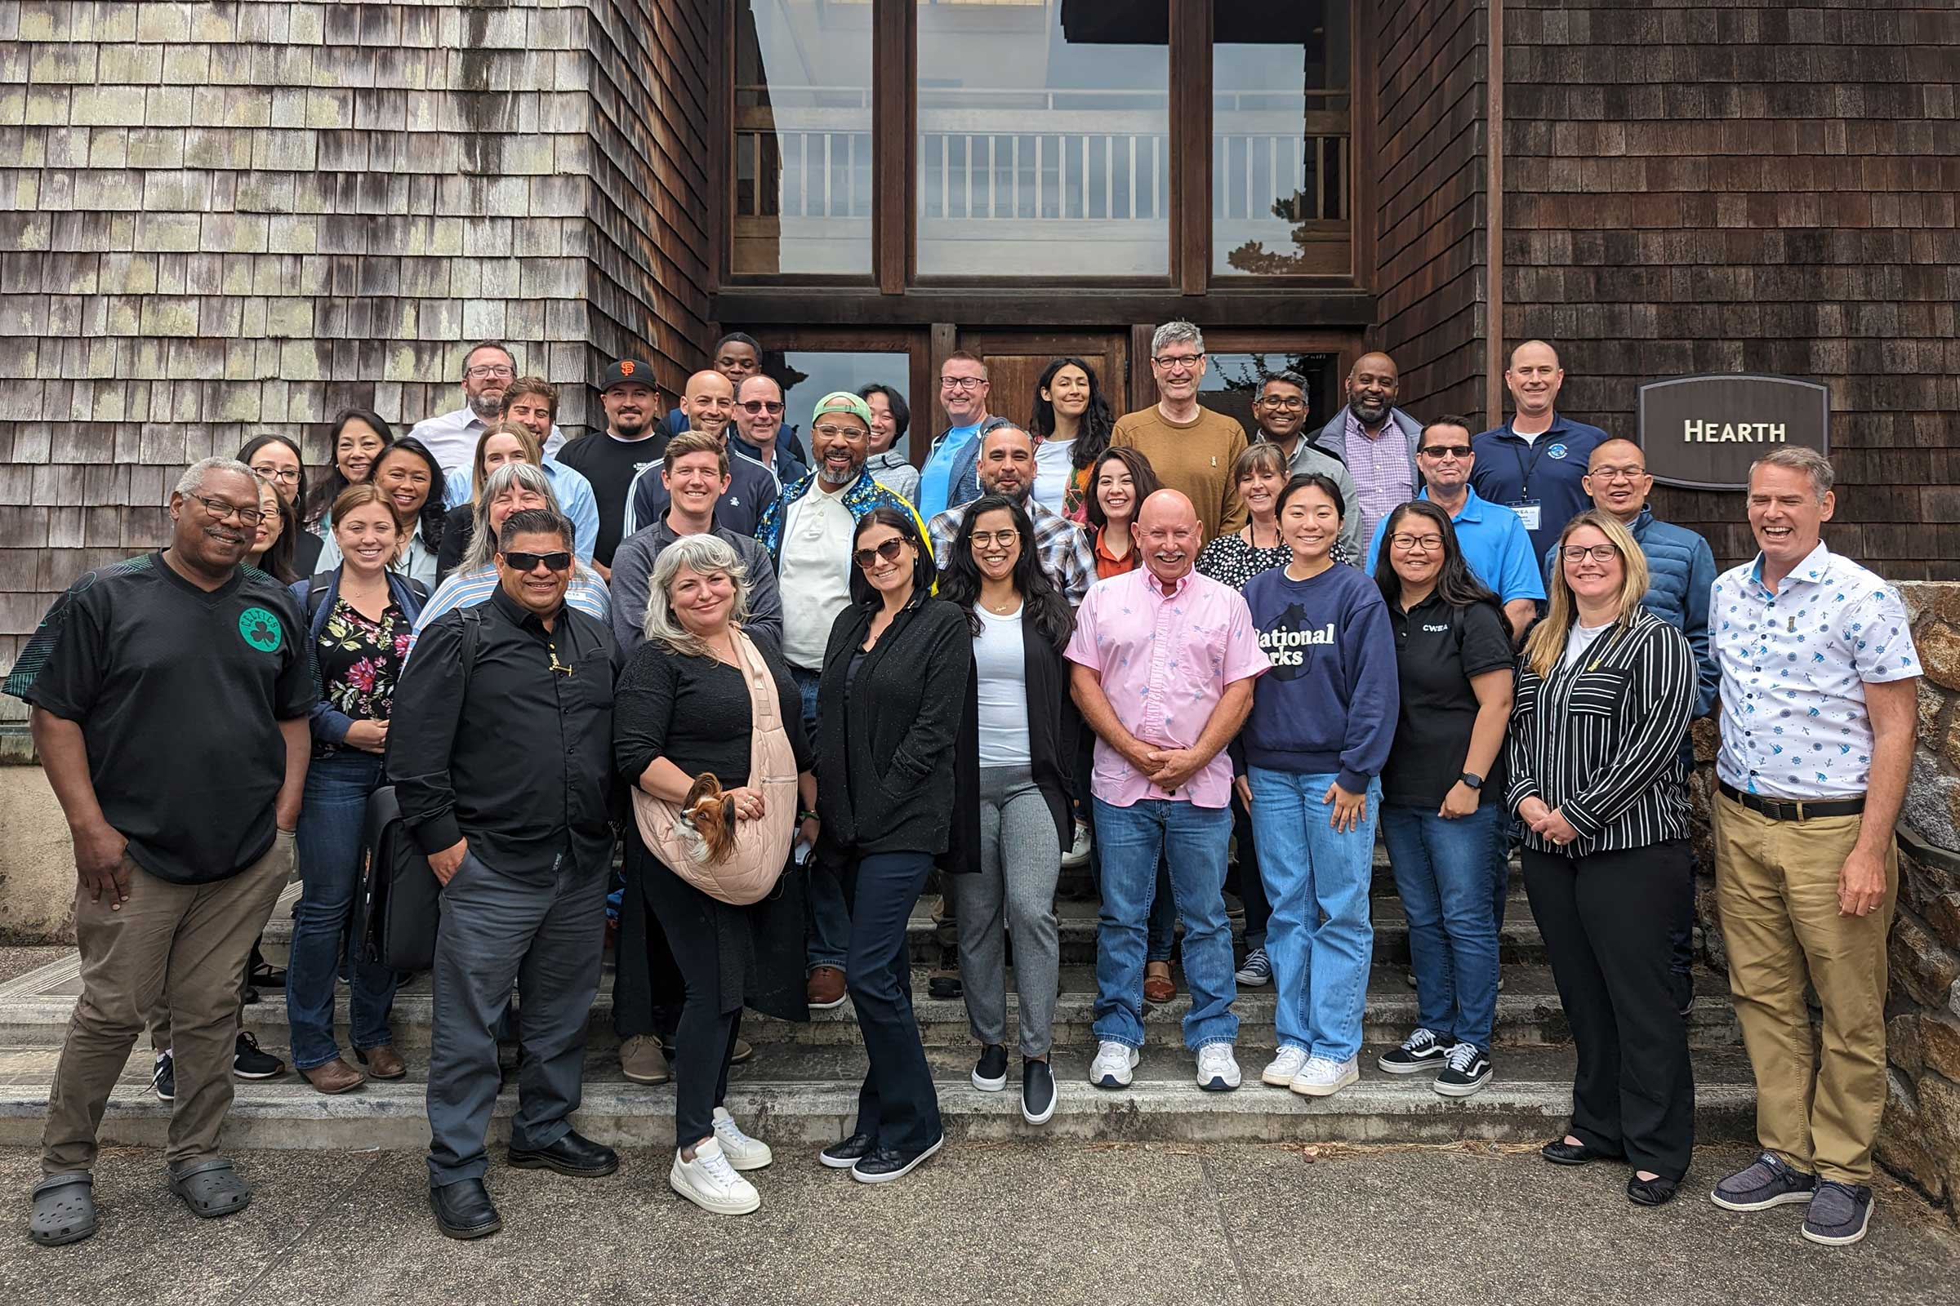
THANK YOU!
…and please save the date for the 2024 CWEA Leadership Retreat, June 11-13 in Palm Springs
CWEA 2023 Leadership Retreat, Asilomar State Park Hotel & Conference Grounds, © CWEA
Notes:
Thanks for having me
Introduce yourself if no one has
Thank the local section leadership for being there. We do all this work together – maybe tell a little of your story as a volunteer with CWEA and how you got involved and how it is meaningful to your career.

Slide 4
California
Water
Environment
Association
ABOUT CWEA
Notes:
Thank the local section leadership for being there. We do all this work together – maybe tell a little of your story as a volunteer with CWEA and how you got involved and how it is meaningful to your career.

Slide 5

CWEA Is a Tax-Exempt 501c3
CWEA annually files tax returns (which includes activities of our local sections and committees) under one Federal Tax ID Number
In order to maintain 501c3 tax-exempt status all activities planned must support our mission.
Mural in CWEA office by Nigel Sussman, © CWEA

Slide 6


MISSION
Empowering, educating,
and connecting water professionals to protect public health and the environment.
VISION
A sustainable California water environment.
Mural in CWEA office by Nigel Sussman, © CWEA

Slide 7

CWEA Board
17 Members
CWEA Local Sections
CWEA Committees
16+ State Committees & Work Groups, Plus Local Committees!
17 Sections
100% Volunteer Leaders – Just Like You!
Adobe

Slide 8
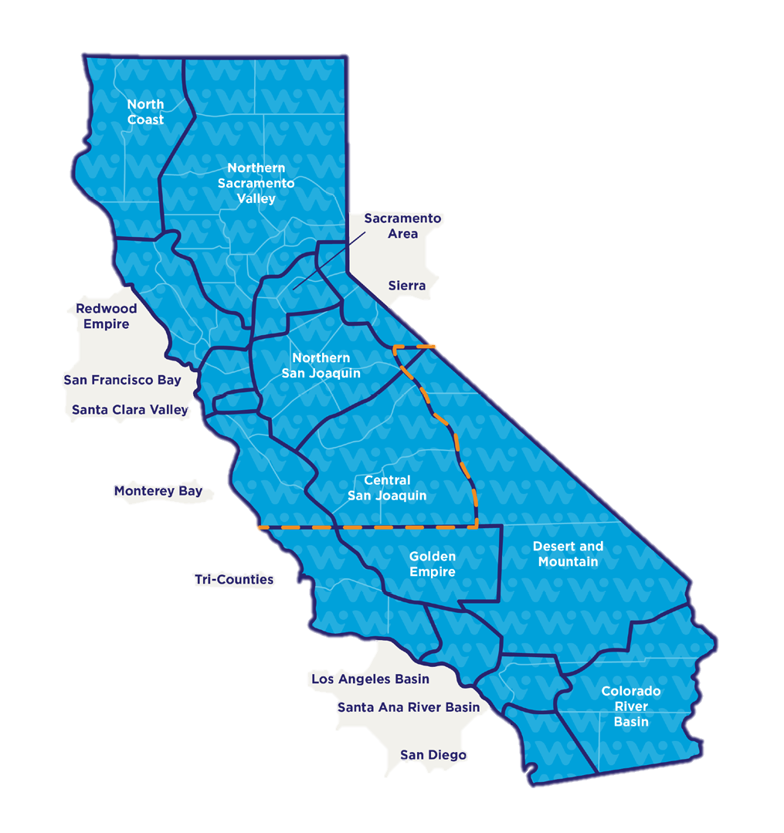
















LOCAL SECTIONS, LOCAL OPPORTUNITIES
Notes:
17 local sections across the state, divided into the Norther Regional and Southern Regional Committees
Discuss the importance of participating in NRC/SRC
- get organizational updates from volunteer leaders and key staff
- find out about opportunities to collaborate across sections
- learn about successful programs from other local leaders you can replicate at your section.

Slide 9
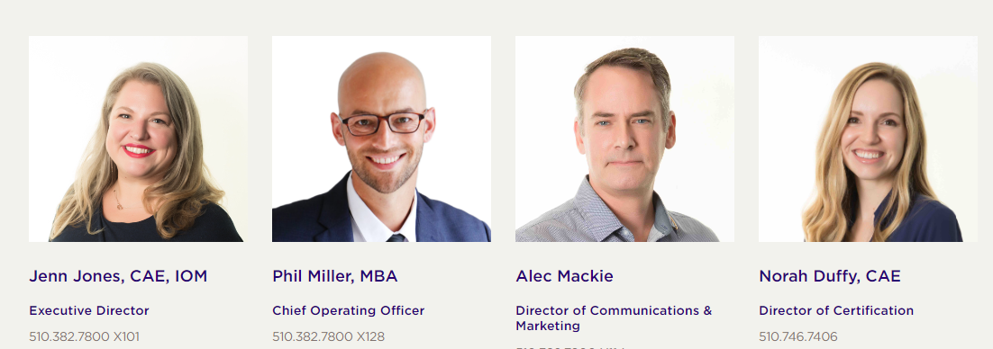
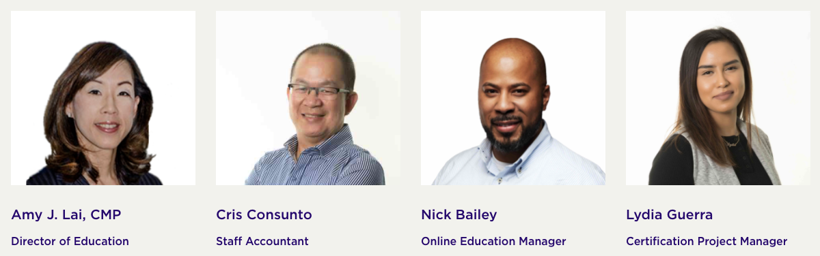
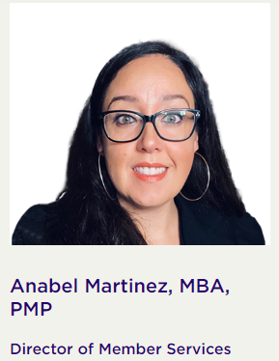
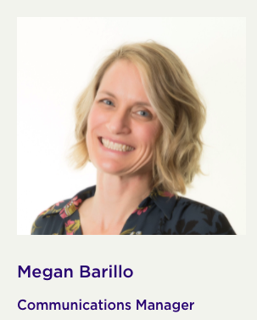

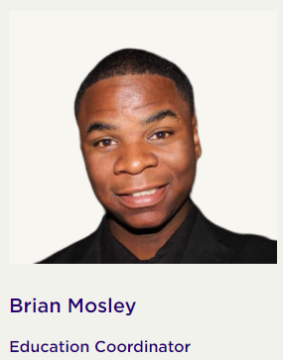
Your Dedicated CWEA Staff Team
Supporting the Strategic Direction of the CWEA State Board
Victoria Thornton
Executive Assistant
Merin Lund
Member Services Specialist
Meuy Saechao
Member Services Specialist
Stephen Yang
Member Services Specialist
Cela Gonzalez
Marketing Coordinator
Melanie Guillen
Education and Events Manager
Jennyfer Corona
Certification Coordinator
Notes:
All of this work is supported by CWEA’s professional staff, who execute the program of work on behalf of the CWEA Board of Directors.

Slide 10
California
Water
Environment
Association
KEY CONSIDERATIONS
FOR LOCAL SECTION LEADERS
Notes:
Thank the local section leadership for being there. We do all this work together – maybe tell a little of your story as a volunteer with CWEA and how you got involved and how it is meaningful to your career.

Slide 11
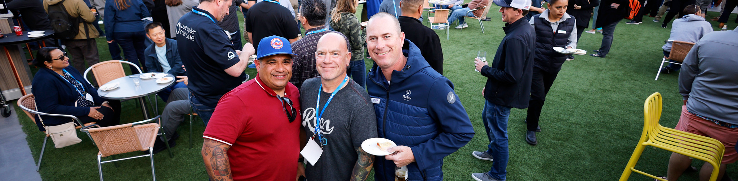
LOCAL SECTION OFFICERS
Critical link between the local section and CWEA State Board
Responsible for determining annual plan of work and activities of the section
Responsible for budget planning and implementation
Key role in supporting State Board to meet fiduciary responsibilities and advance the CWEA Strategic Plan
Responsible for engaging local section members and driving member value
CWEA AC23 in San Diego, CA, © Sal Ochoa
Notes:
Reminder of the importance of the LS Officer and the role they play

Slide 12
YOUR CWEA BOARD LIAISON
A Local Section’s conduit and connection to the organization and its resources. We are here to help you with anything, including:
Ideas
Advice
Resources
Communications
CWEA AC23 in San Diego, CA, © Sal Ochoa
Notes:
Luckily, you have help!

Slide 13
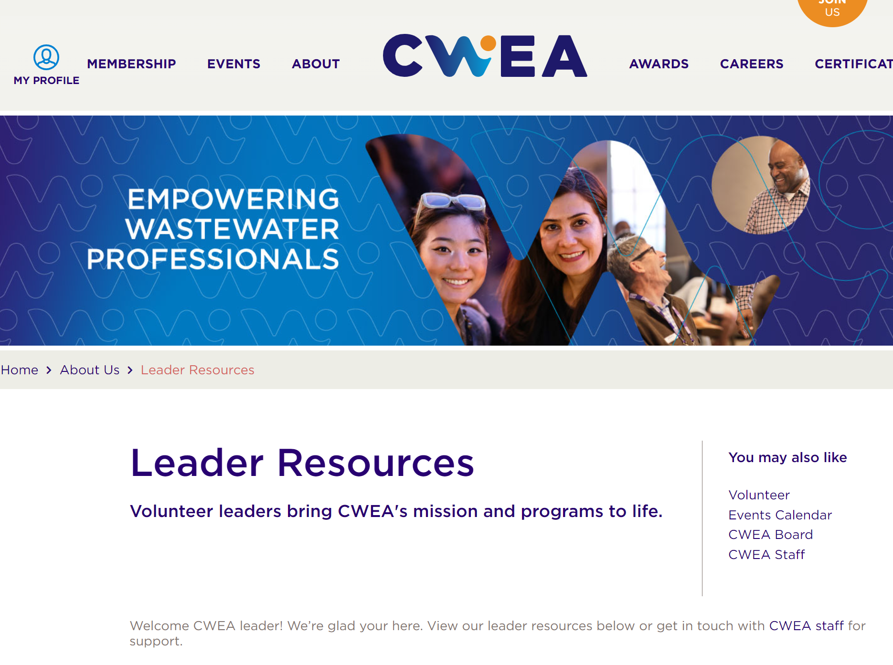
leaders.cwea.org
Resources on the Leader Resources web page include:
Local Section bylaws
Templates
Forms
Policies
How-to guides
Notes:
Tons of resources available on the CWEA website, accessible by visiting leaders.cwea.org

Slide 14
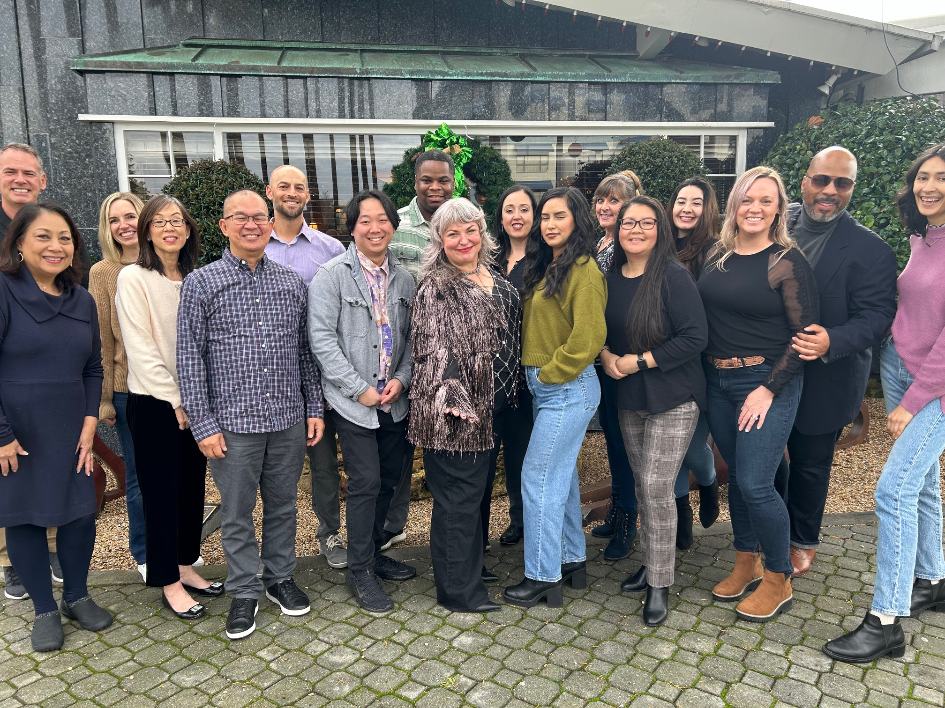
DEDICATED CWEA STAFF SUPPORT
Finance | Website, Photo Galleries & Marketing | Event Set-Up | Webinar Set-Up
Cris Consunto | Cela Gonzalez | Brian Mosley | Nick Bailey
cconsunto@cwea.org | help@cwea.org | help@cwea.org | nbailey@cwea.org

Slide 15
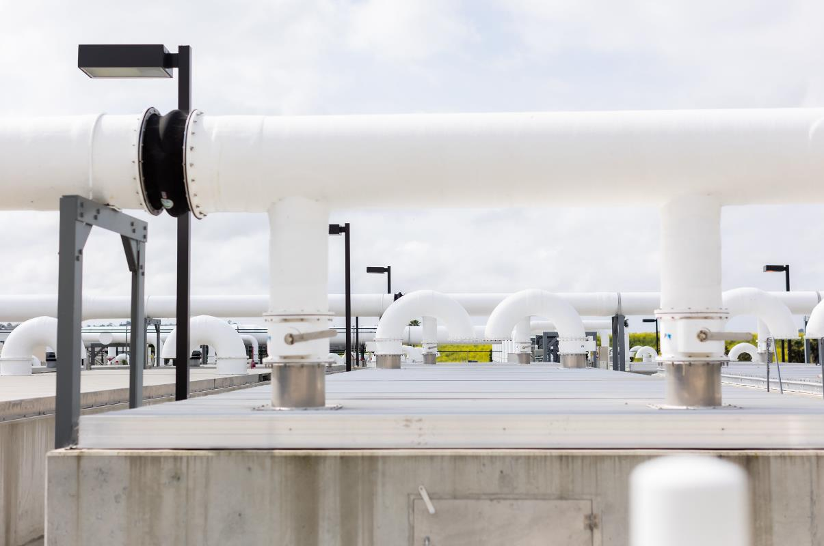
FINANCIAL REPORTING, COMPLIANCE
Credit: Olivia Rakowski
Notes:
NOTE: This section can be skipped if LS bookkeeping is done by HQ.

Slide 16
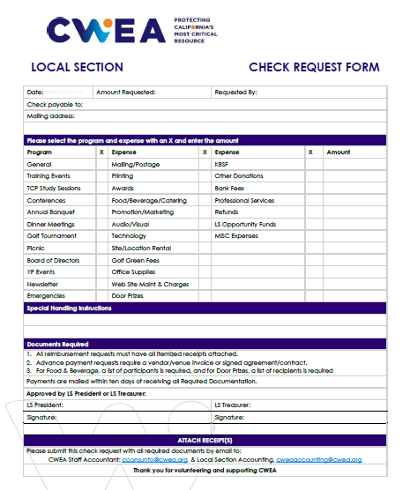
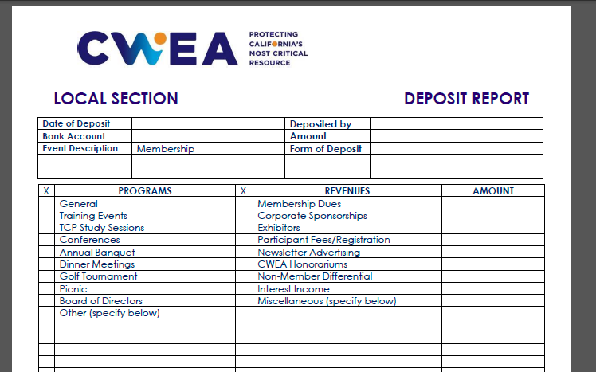
Reporting, Documentation
Notes:
Reminder that documentation is important, timely, and ensures compliance and good legal, nonprofit standing.

Slide 17
Treasurer Compliance Tasks
Budget - Fiscal Year 24-25
Monthly Financial Reports
Excel version of Reporting Template
Invoices/Receipts
Check Request Forms
Check Images
List of all gifts/prizes & recipients list
Deposit receipts with detail
Petty Cash Register
Bank Statement Reconciliation
List all outstanding checks and deposits
List of attendees for meal & entertainment expenses
Due March 29, 2024
Notes:
Review of compliance tasks required of LS Treasurers

Slide 18
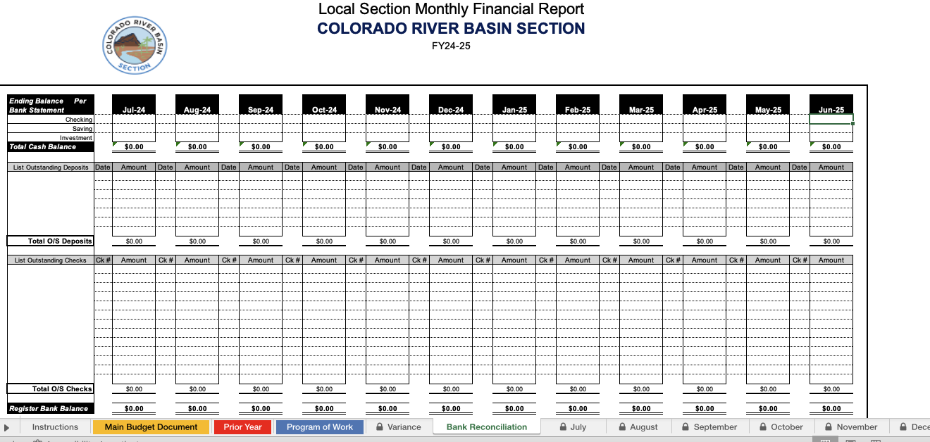
Reporting, Documentation
Notes:
Local sections who do their own books must do a monthly bank reconciliation and submit to CWEA. When CWEA does LS books CWEA takes care of this task

Slide 19
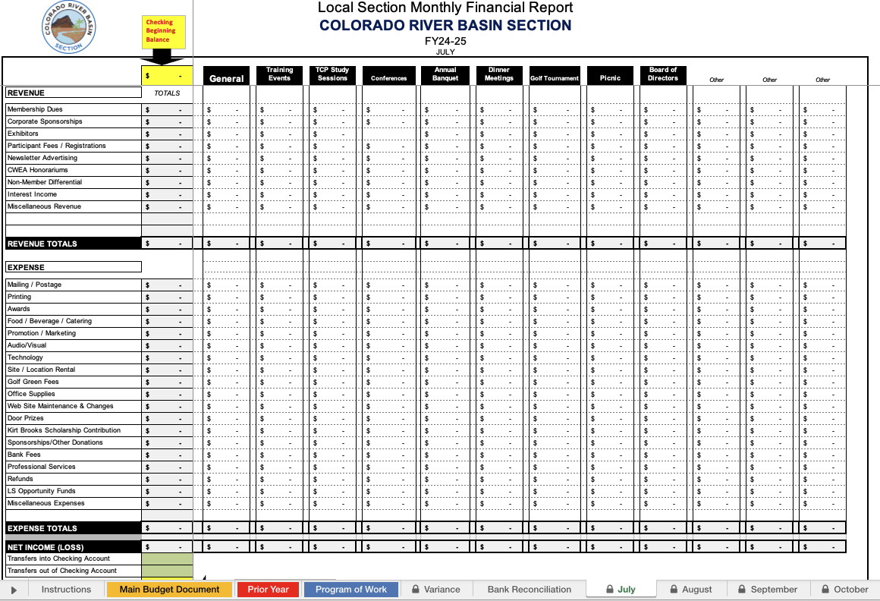
Reporting, Documentation
Notes:
Local sections who do their own books must do a monthly expense and revenue summary and ensure that the beginning and ending balances tie to the monthly bank statement. When CWEA does LS books CWEA takes care of this task

Slide 20
State vs. LS Bookkeeping
Task | With bookkeeping service | Without bookkeeping service
Budget | X | X
Deposit receipts | X | X
Description of revenue received | X | X
List of attendees | X | X
List of all gifts/prizes and recipients | X | X
Check Request Forms | X | X
Invoices/receipts |  | X
Electronic version (i.e. Excel file) of report |  | X
Check Images |  | X
Check Register |  | X
Bank Statement Reconciliation |  | X
Merchant/Event account Reconciliation |  | X
Timely Submit monthly report |  | X
Notes:
Reminder – state bookkeeping service is designed to make life easier for LS Treasurers

Slide 21
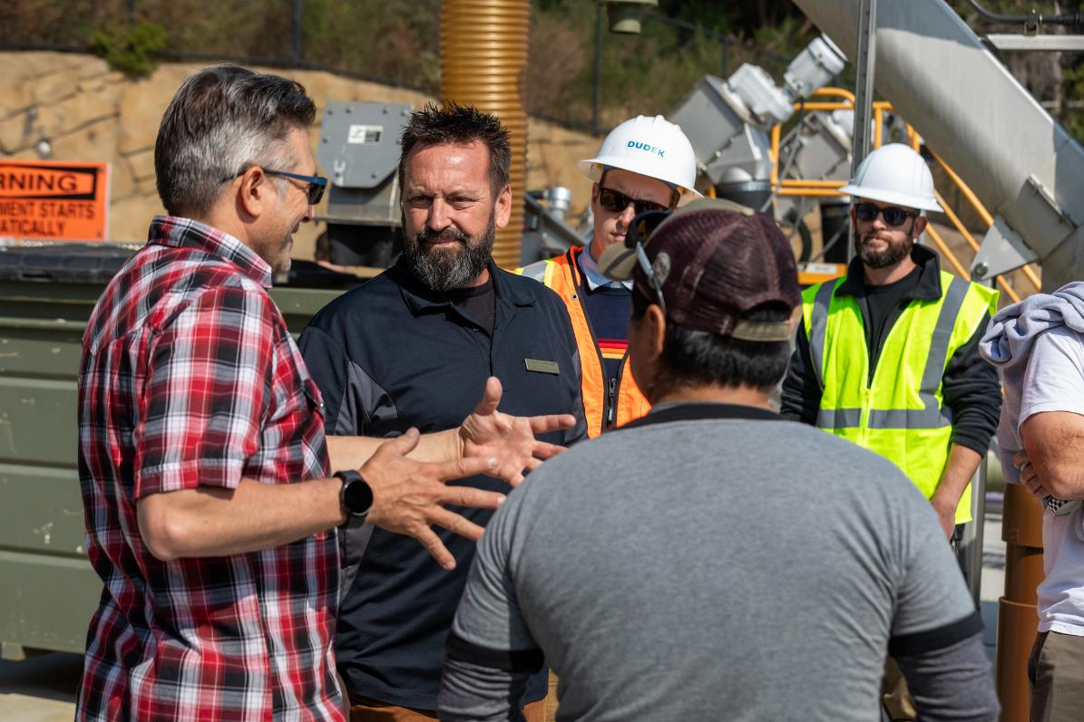
LOCAL EVENTS, IN-PERSON & ONLINE
Credit: Kelly Sullivan
Notes:
PRESENTER - MARK

Slide 22
Help with Events, Artwork & Websites
EMAIL
help@cwea.org
Notes:
We’re making it easier for Local Sections to contact staff.
Email help@cwea.org to get your request going.

Slide 23
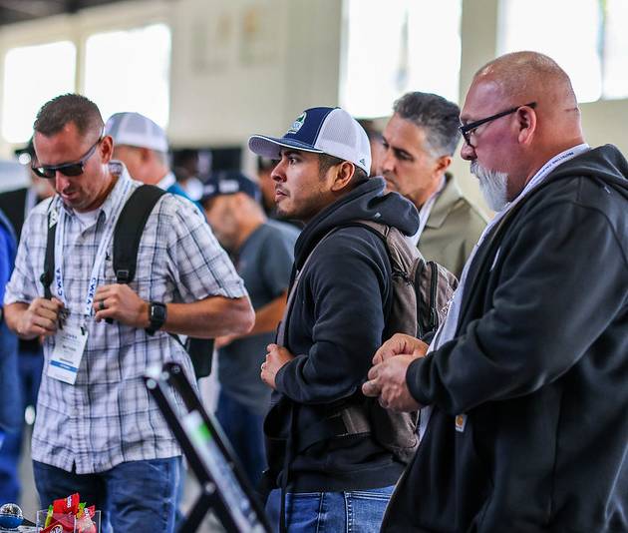
Steps to Schedule an Event
EVENT
SET-UP
Visit events.cwea.org, click “Add an Event”
Submit your event details
Brian and the team will assist with setting-up
your event in the CWEA registration system
Questions? We’re here for you at help@cwea.org
CWEA’s
system automates contact hour fulfillment
Aubrey McCann

Slide 24
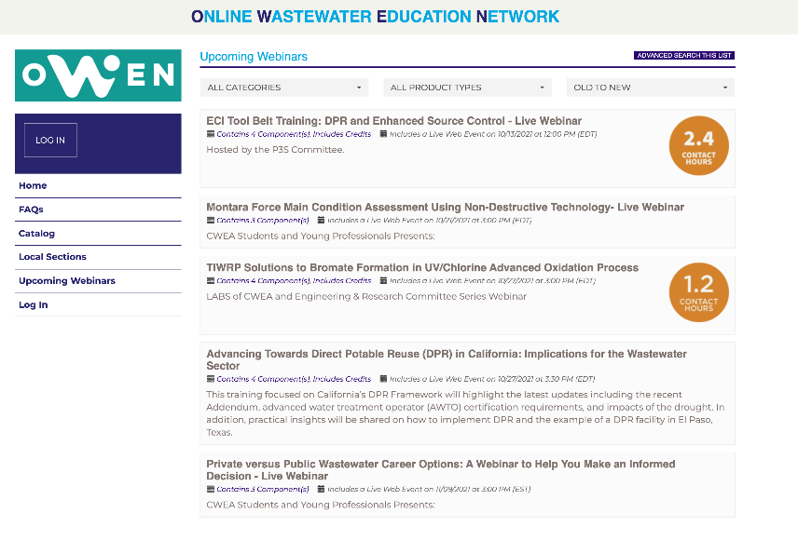
Steps to Schedule a Webinar
WEBINAR
SET-UP
Please contact
Nick Bailey, CWEA's Online Education Manager nbailey@cwea.org 60 days in advance.
Provide details on the session and speaker.
Webinars are recorded
and appear on OWEN w/in 7-10 days

Slide 25
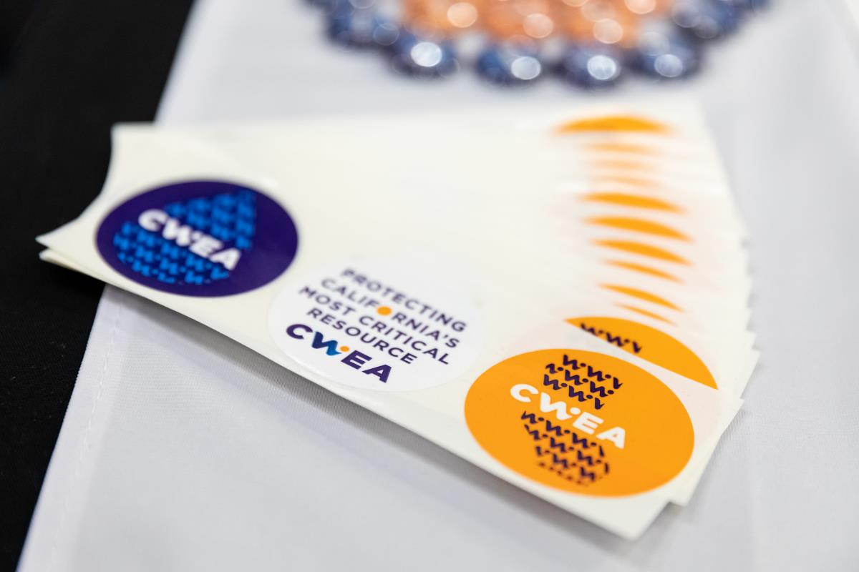
HOT TOPICS AND KEY CONSIDERATIONS
Credit: Kelly Sullivan
Notes:
PRESENTER - MARK

Slide 26
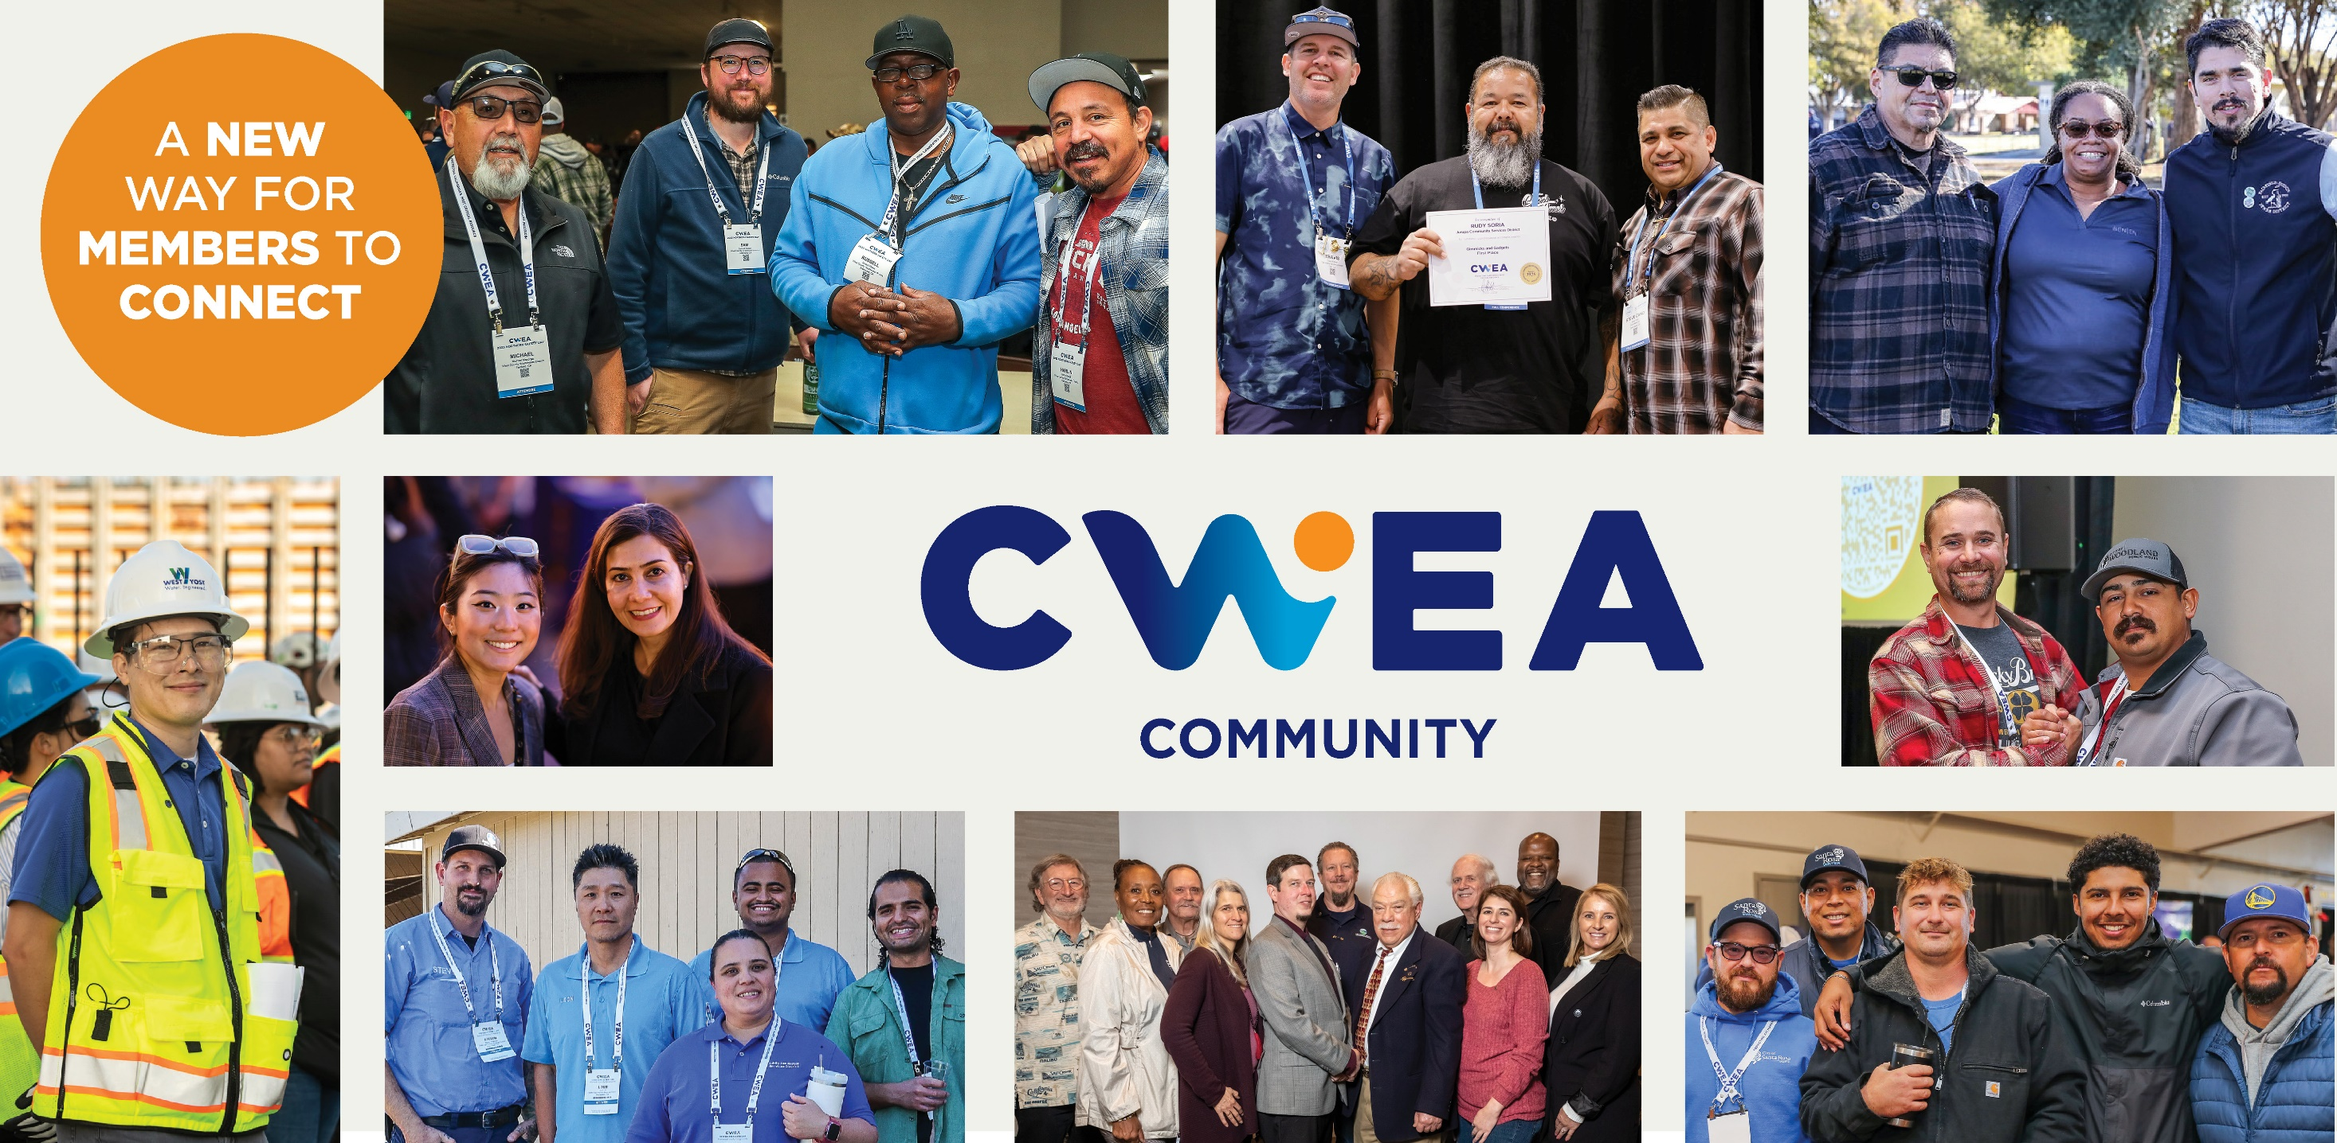

Photo credits (top, clockwise): Audrey McCann; Sal Ochoa (2 photos); Audrey McCann (2 photos); Kelly Sullivan; Audrey McCann; and Kelly Sullivan.
community.cwea.org
Notes:
CWEA Community is a new online platform to facilitate conversations amongst members based on their interest areas and location –
it is a great way to
engage with local members,
generate interest in volunteering,
and get help for events.
We will be discussing ways to leverage this platform at upcoming NRC/SRC meetings – please come with recommendations, suggestions and success stories!

Slide 27
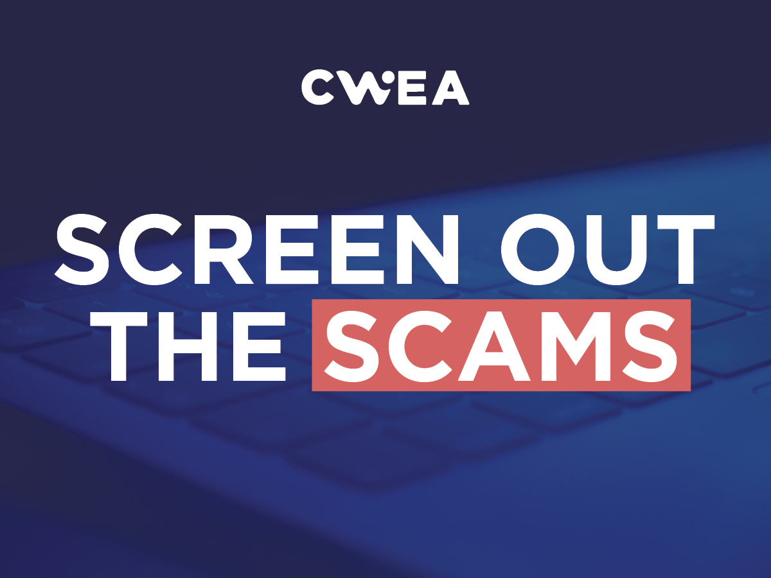
HEADS-UP
CWEA staff and leaders will never ask you to purchase items or pay vendors on their behalf.
Notes:
Be aware of email scammers.
CWEA staff and leaders will never ask you to purchase items or pay vendors on their behalf.
Visit leaders.cwea.org more info about avoiding scams.
Also be aware of copyrights on photos, artwork, music and videos.
Ask CWEA staff for guidance whenever you need it.

Slide 28

HEADS-UP
RAFFLE
Microsoft Stock
Notes:
Raffles are regulated in the state of California as a game of chance by the Office of the Attorney General.
Allowing additional chances to win in exchange for a scholarship donation also counts as a raffle.
ADD MORE

Slide 29
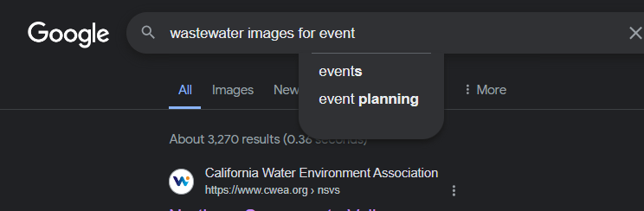
HEADS-UP
IMAGE COPYRIGHT CONSIDERATIONS
Google and the Google logo are trademarks of Google LLC
Notes:
All images mush have appropriate copyright clearance and attribution to the copyright holder and/or photographer.
You cannot download or use images from Google or any other search engine without seeking permission from the copyright holder.

Slide 30
QUESTIONS?

